Slide 1


Slide 2


Current IT System Used by Operator
eHIS
PACS
SAP
Mobile Apps (Connect-MD/Executive Apps and PHR)
Servers and storages
Network
IT Helpdesk

Slide 3
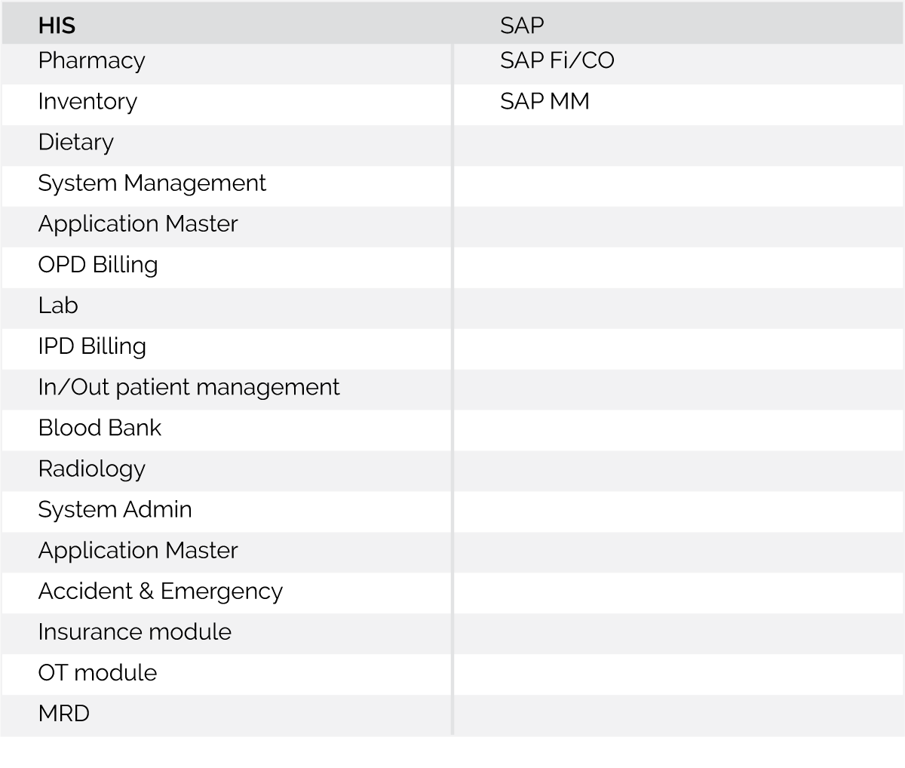
ERP SYSTEM

Slide 4
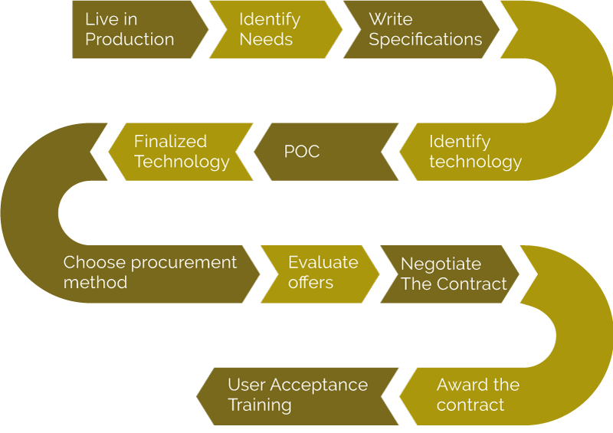
Implementation & evaluation experience

Slide 5
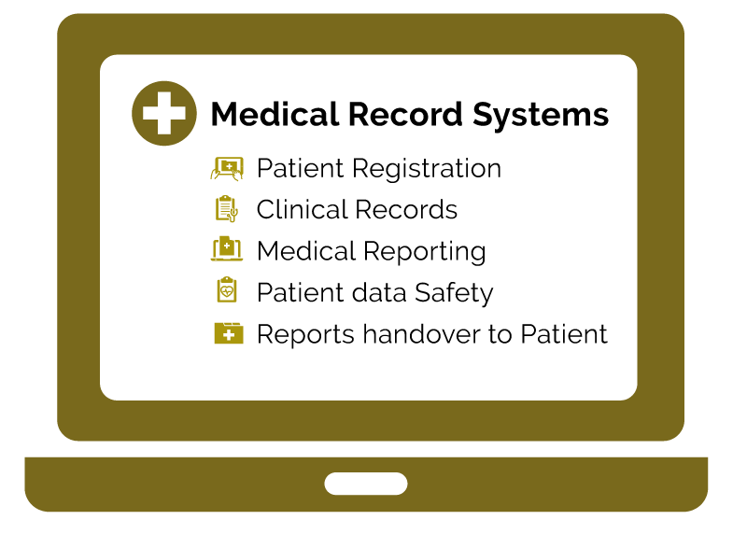

Slide 6
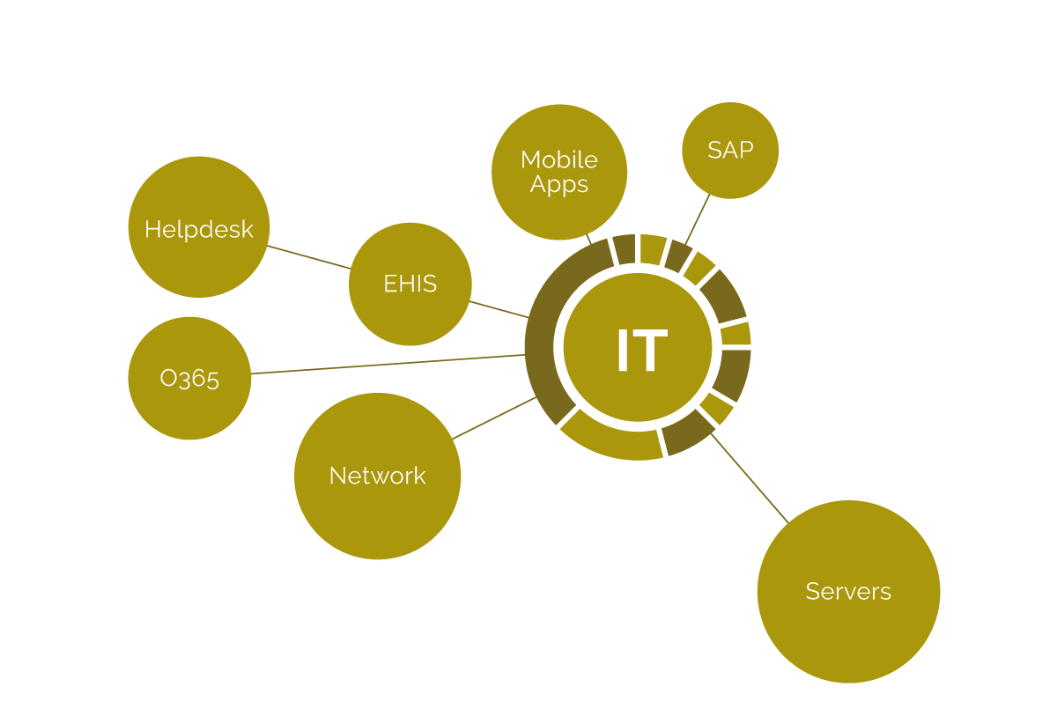
Centralized IT operations

Slide 7


