Slide 1
www.kgmcindia.com
Notes:
Page No 1

Slide 2
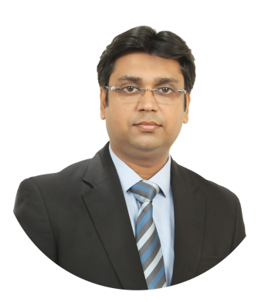
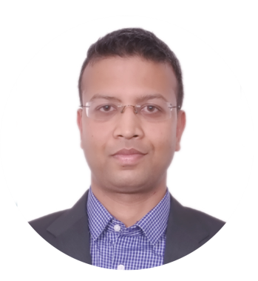
FOUNDERS
KGMC INDIA
Mohit Goyal
Vipin Kumar
Chartered Accountant
Chartered Accountant
Mohit accomplished his CA in the year 2008. Then, after serving for approximately 2 years in industry, he started his own CA firm in the name of Mohit Goyal & Associates. His areas of practice are accounting, income tax, service tax & VAT. Apart from CA qualification, Mohit also have membership of Institute of Director since September 2013 and qualified master classes for directors leading to the award of “Certified Corporate Directorship”.
Vipin accomplished his CA in the year 2007. Then, after serving for approximately 7 years in industry, he joined Mohit Goyal & Associates as partner and firm name was changed to Kumar Goyal & Associates LLP. Out of 7 years in industry, he has worked with Voltas Limted for approximately 2 years in internal audit department. His areas of practice include accounting, internal audit & process outsourcing.
2

Slide 3
About us
The objective of KGA is to achieve excellent in accounting & financial services which leads to superior business performance.
At KGA, our values form the core of our organizational functioning. It determines the corporate culture of our company, speaks about our persona, and defines the way we will react in situations of crisis. They influence the way we behave towards our shareholders, partners, employees, customers and community.
Value Creation
We aim to create value for our:
a) Customers by providing them superior service and deep insights with an easy to work sales and delivery team.
b) Employees by providing them great working conditions, learning and development and growth opportunities.
Customer Orientation
We know that customers are the heart and soul of our business. As such, we invest heavily on listening to our customers and understanding their needs and wants. Not only do we just listen to them but we continuously learn and improve upon our services provided to them.
Integrity
We believe in trust, respect, honesty and transparency. We focus on building trust and honesty by respecting people across different cultures. We work ethically and we walk our talk by delivering what we promise.
Innovative
We challenge the routine way of doing things and accept new ideas. We think big. We think smart. We think out of the box.
3

Slide 4
Our services
Accounts
Outsourcing
Internal Audit
Startup in India
GST in India
Financial Process
Outsourcing
Reconciliation
Services
Accounts Receivable
management
4

Slide 5
Thank You
For Enquiries
91-124-4377835
Email: www.kgmcindia.com
B-97, Ground Floor, Udyog Vihar ,
Phase-V, Gurugram – 122016t

